Slide 1


PRACTICE
WHAT WILL THE CODE A & B PRINT?
5 MIN
INDIV
x = 10
if x > 4:
print("A")
elif x > 2:
print("B")
x =10
if x > 4:
print("A")
else :
if x > 2:
print("B")
A
B
>A
>A

Slide 2
PRACTICE
WHAT WILL THE CODE PRINT?
5 MIN
INDIV
X = 3
if x > 4:
print("A")
elif x > 2:
print("B")
> nothing

Slide 3
PRACTICE
WHAT WILL THE CODE PRINT?
5 MIN
INDIV
x = 1
if x > 4:
print("A")
elif x > 2:
print("B")
> nothing

Slide 4
PRACTICE
WHAT WILL THE CODE PRINT?
5 MIN
INDIV
x = 7
if x > 4:
print(“A")
if x > 2:
print(“B")
>A
B

Slide 5

QUIZ
What are the possible
values of isGreater ?
5 MIN
CLASS
Answer= python
x = 6
isGreater = x > 5
if (isGreater == True) :
print (“python”)

Slide 6
QUIZ
5 MIN
CLASS
Answer= python
x = 6
isGreater = x > 5 or x < 10
if (isGreater == True) :
print (“python”)

Slide 7
QUIZ
5 MIN
CLASS
Answer= python
x = 10
isGreater = x > 9
if (isGreater) :
print (“python”)

Slide 8
EXPLAIN
Boolean value
5 MIN
CLASS
A boolean is a value that can be only
True or False

Slide 9
QUIZ
What is the difference between
the 2 codes
5 MIN
CLASS
x = 6
isGreater = x > 5
if (isGreater == True) :
print (“python”)
x = 6
isGreater = x > 5
if (isGreater) :
print (“python”)
A
B
C
Same Same
Different
I don’t know

Slide 10

EXPLAIN
A variable’s value
can be of different types
5 MIN
CLASS
integer
decimal
Type | Possible values
Number | 1 , 3, 4.58
Boolean | True, False
My type of value is number
My type of value
is boolean
3
True
Uppercases !!
BOB
BIBI

Slide 11
QUIZ
What is the difference between
the 2 lines of code?
5 MIN
CLASS
X = 5
X == 5
A
B
C
Same Same
Different
And I know
Different
But I don’t know

Slide 12
EXPLAIN
Boolean expression
1 MIN
CLASS
A Boolean expression is a composition of Boolean values using or/and/not operators

Slide 13
QUIZ
What will be the value of BOB?
5 MIN
CLASS
X > 5
True
X = 0
Y = 4
Z = 5
OR
BOB
A
B
C
True
False
I don’t know

Slide 14
QUIZ
What will be the value of BOB?
5 MIN
CLASS
X > 5
Z > Y
X = 0
Y = 4
Z = 5
AND
X < 1
OR
BOB
A
B
C
True
False
I don’t know

Slide 15
QUIZ
Write this code in python on paper
5 MIN
CLASS
X > 5
Z > Y
AND
X < 1
OR
BOB

Slide 16
QUIZ
WHAT WILL THE CODE PRINT?
5 MIN
CLASS
x = 13
print ( x > 7 or (x > 2 and x < 6))
> True

Slide 17
QUIZ
WHAT WILL THE CODE PRINT?
5 MIN
CLASS
x = - 5
print ( x > 7 or (x > 2 and x < 6))
> False

Slide 18
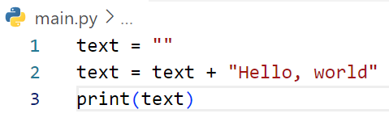
What is output of cod below?
Answer: Hello, world

Slide 19
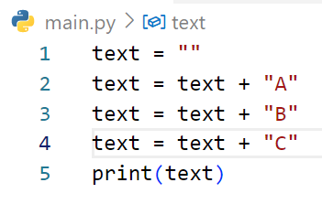
What is output of cod below?
Answer: ABC

Slide 20
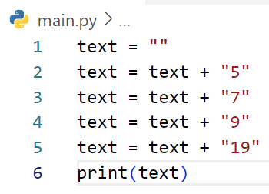
What is output of cod below?
Answer: 57919

Slide 21
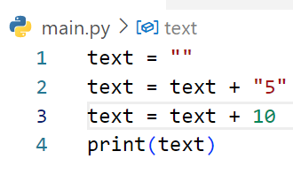
What is output of cod below?
Answer: Erro

Slide 22
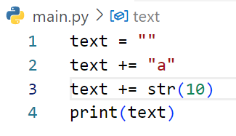
What is output of cod below?
Answer: a10

Slide 23
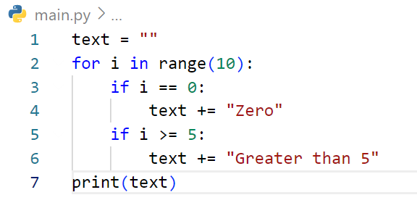
What is output of cod below?
Answer: ZeroGreater than 5Greater than 5Greater than 5Greater than 5

Slide 24
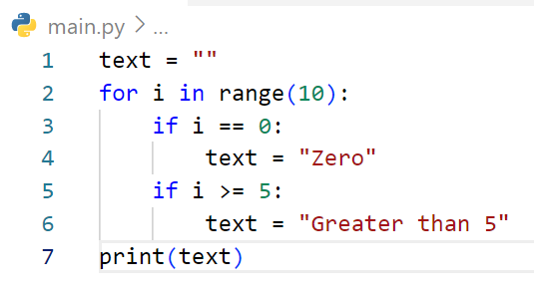
What is output of cod below?
Answer: Greater than 5

Slide 25
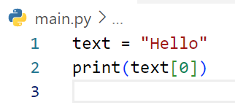
What is output of cod below?
Answer: H

Slide 26
What is output of cod below?
Answer: H

Slide 27
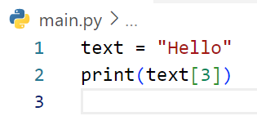
What is output of cod below?
Answer: l

Slide 28
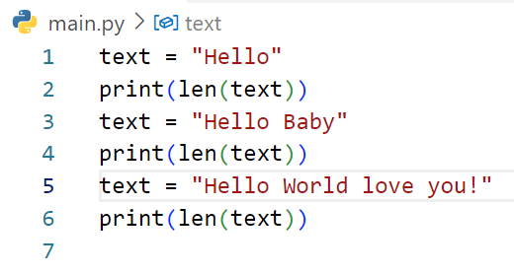
What is output of cod below?
Answer: 5
9
21

Slide 29
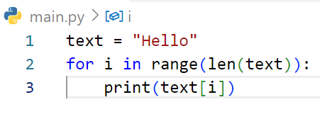
What is output of cod below?
Answer: H
e
l
l
o

Slide 30
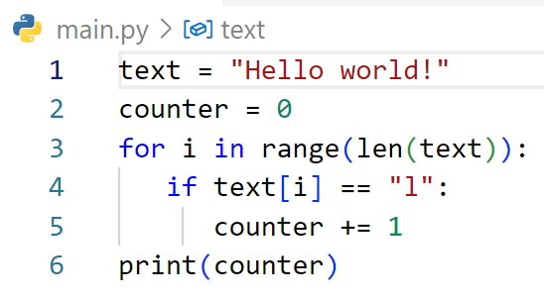
What is output of cod below?
Answer: 3

Slide 31
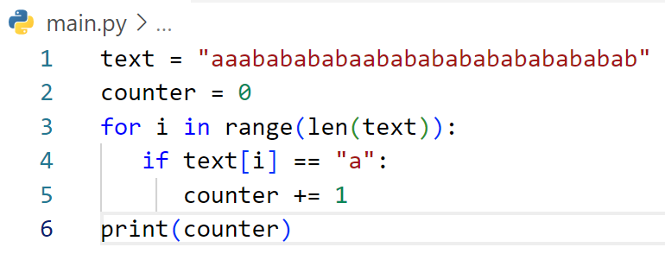
What is output of cod below?
Answer: 17

Slide 32
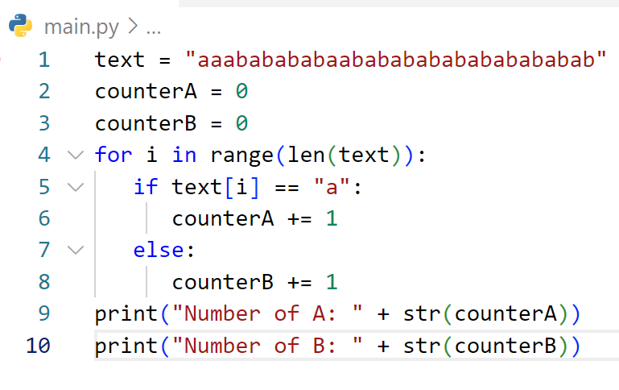
What is output of cod below?
Answer: Number of A: 17
Number of B: 14

Slide 33
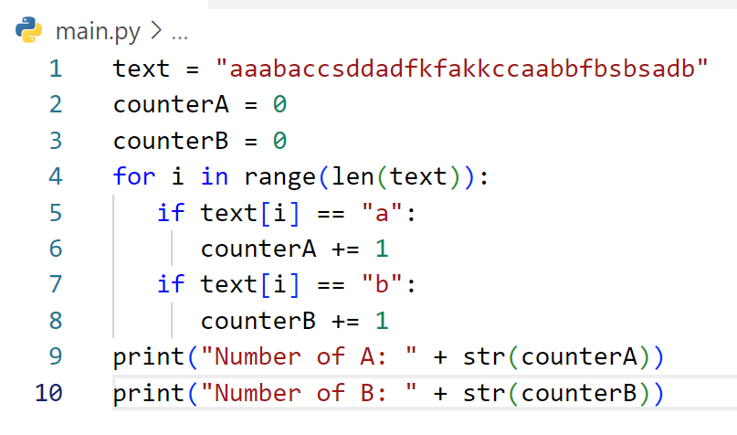
What is output of cod below?
Answer: Number of A: 9
Number of B: 6

Slide 34
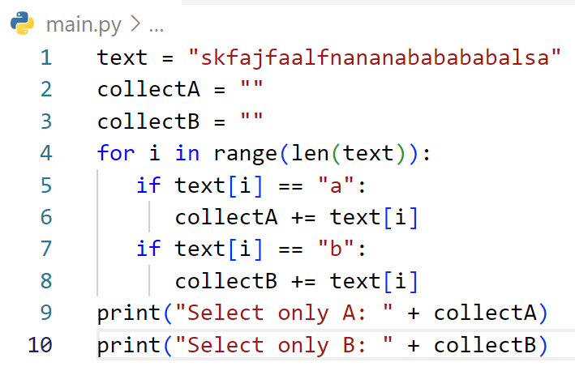
What is output of cod below?
Answer: Select only A: AAAAAAAAAA
Select only B: BBBB

Slide 35
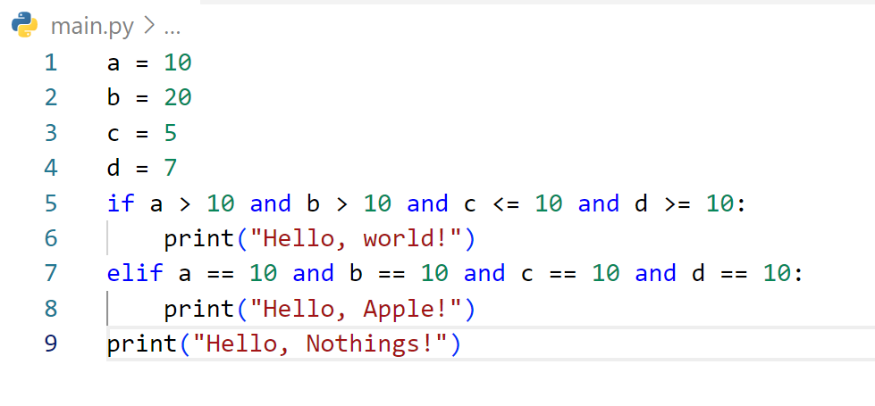
What is output of cod below?
Answer: Hello, Nothings!

Slide 36
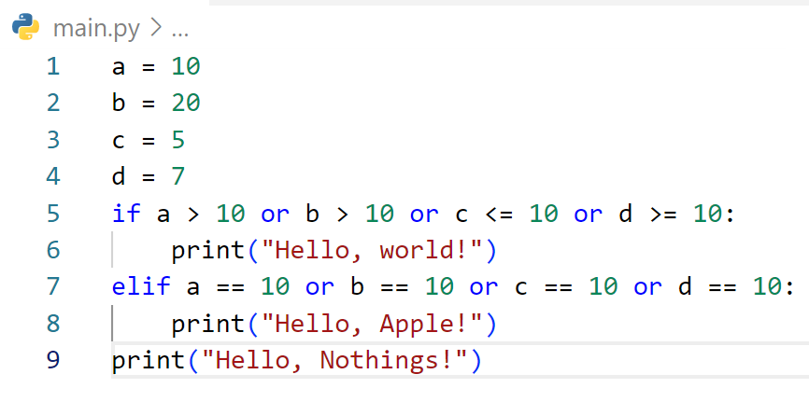
What is output of cod below?
Answer: Hello, World!
Hello, Nothings!

Slide 37
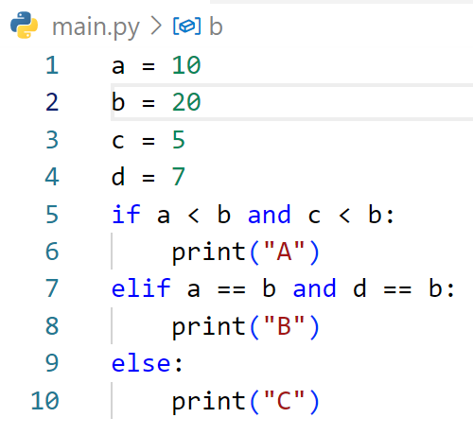
What is output of cod below?
Answer: A

Slide 38
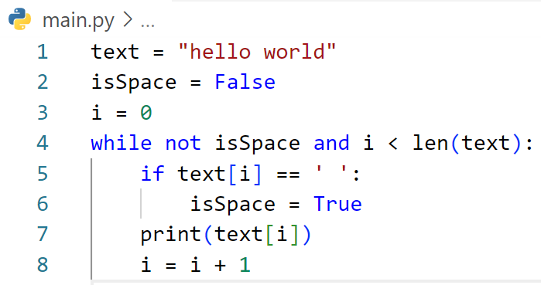
What is output of cod below?
Answer: h
e
l
l
o

Slide 39
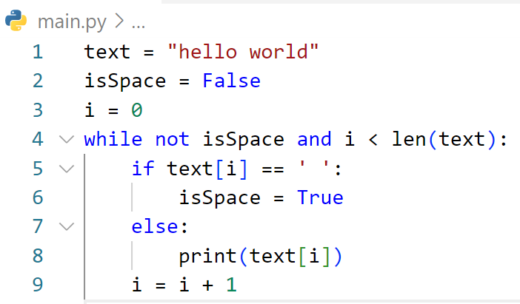
What is output of cod below?
Answer: h
e
l
l
o

